Slide 1
Torque
Success Criteria
I can define torque as a turning effect.
I can calculate the torque applied to an object.

Slide 2
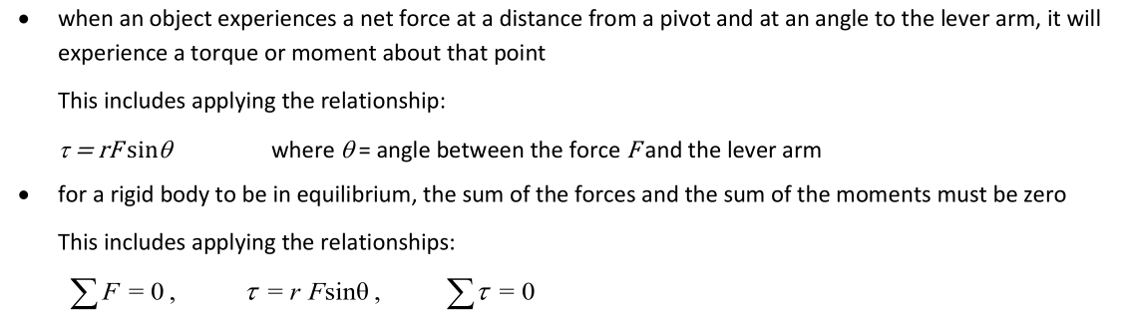
Torque
Link to Syllabus

Slide 3
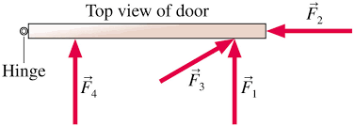
Torque
Content Development
Door experiment
When pushing on the door, the farther from the hinge, the easier it was to move the door.
The door is a lever, moving around a fulcrum or pivot (the hinge). Pushing on the door supplies a turning effect to the door.
The turning effect is a function of the force applied in the correct direction and distance from the pivot.

Slide 4
Torque
Content Development
The turning effect is called the torque or moment. It occurs when an object turns around a pivot (also known as the axis of rotation). The torque is the product of the force acting perpendicular to the axis of rotation and the distance from the pivot.
The angle is important!
Pushing a door at an angle to the axis of rotation is less effective than pushing it straight on. This is because the perpendicular force is lower when at an angle.
axis of rotation
F₁: far from pivot; perpendicular to axis → high torque
F₂: far from pivot; parallel to axis → no torque
F₃: far from pivot; angled → low torque
F₄: close to pivot; perpendicular to axis → low torque

Slide 5
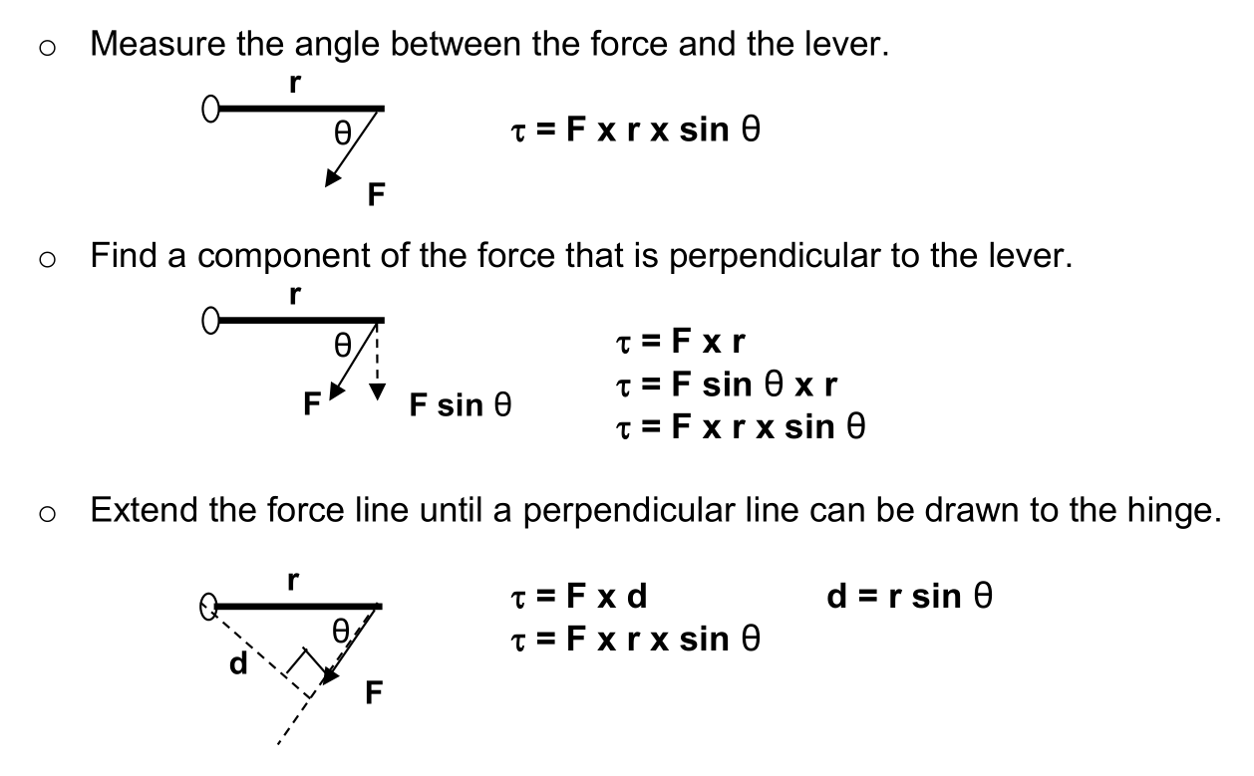



Torque
Content Development
Torque is measured in N m (newton-metres) and represented with the symbol $τ$ (Greek letter tau). It can be calculated in three ways:
Find perpendicular force
Find perpendicular distance
Measure angle between force and the lever.
$$τ=r×F┴$$
$$τ=r┴×F$$
$$τ=r×F×sinθ$$

Slide 6
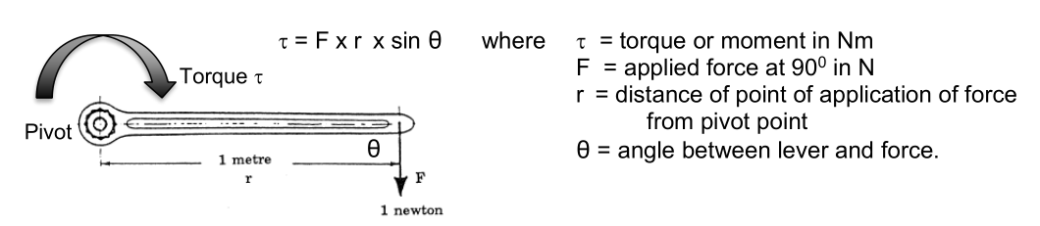
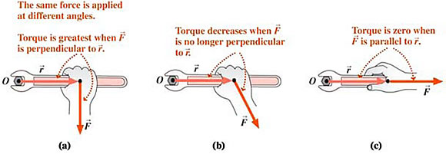
Torque
Content Development

Slide 7
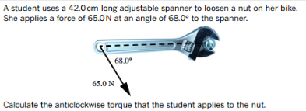




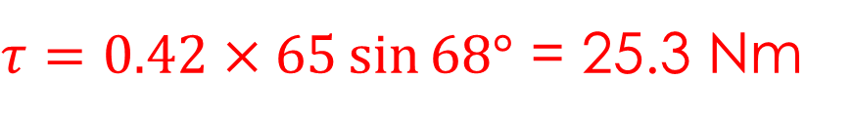



Torque
Content Development
Let’s try out each method.
Find perpendicular force
$$F\text{∥}$$
$$τ=r×F┴$$
$$θ$$
$$F$$
$$F┴$$
$$F_{┴}=F\sin{θ}$$
$$=65\sin{68°}$$
$τ=0.42×65\sin{68°}$ = 25.3 Nm

Slide 8




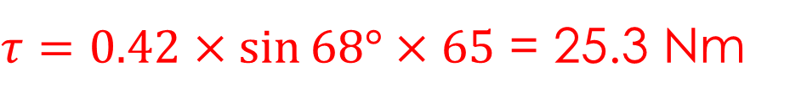

Torque
Content Development
Let’s try out each method.
Find perpendicular distance
$$r$$
$$τ=r┴×F$$
$$θ$$
$$r_{┴}=r\sin{θ}$$
$$=0.42\sin{68°}$$
$$r┴$$
$τ=0.42×\sin{68°×65}$ = 25.3 Nm

Slide 9

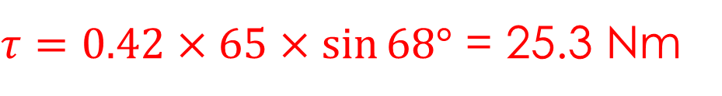


Torque
Content Development
Let’s try out each method.
Measure angle between force and the lever.
$$r$$
$$θ$$
$$τ=r×F×sinθ$$
$$F$$
$$θ=68°$$
$τ=0.42×65×\sin{68°}$ = 25.3 Nm

Slide 10
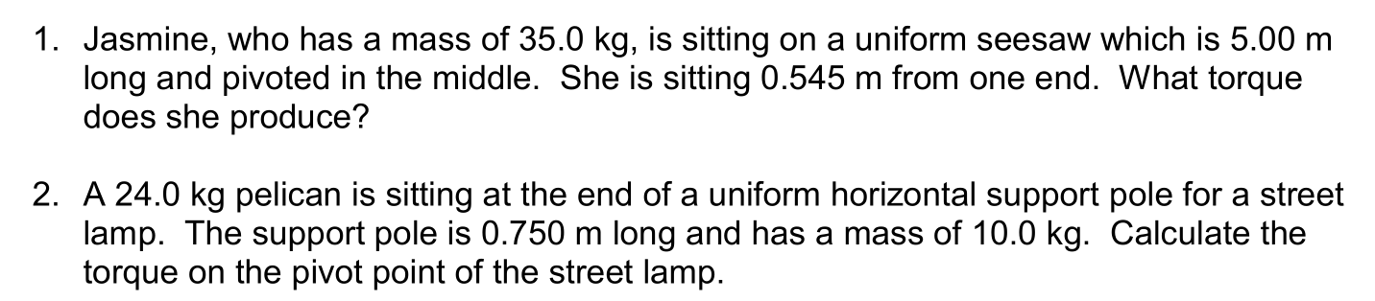
Torque
You Do
Notes:
F = mg
= 35 * 9.8 = 343 N
Torque = Fr = 343*1.955 = 671 Nm

Slide 11
Torque
Note: the weight of the pole acts in the middle (at 0.375m)
You Do
Notes:
Two forces acting here: the weights of both poles
Torque = Fr(bird) + Fr(pole) = 24*9.8*0.75 + 10*9.8*0.375
= 213 Nm

Slide 12
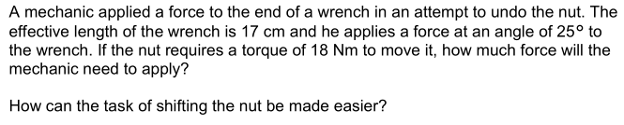
Torque
Draw a picture!
You Do
Notes:
torque = Fr sin theta
F = torque / (r sin theta) = 18 / (0.17 sin 25) = 251 N
How to increase?
- more force
- use a longer handle
- (lower the friction on the nut)

Slide 13
Torque
Exam advice
Be comfortable using all three of the calculation methods. You will likely prefer one of them (I like to use perpendicular force because that makes the most conceptual sense to me) but sometimes it is far easier to use an alternative method.
Be careful with the angles. You might not be given the correct angle for the sinθ equation. Draw a picture and check.
Understand how the force required to provide a certain torque can be reduced (usually it is by changing the angle or increasing the lever arm).

Slide 14
Torque
Success Criteria
I can define torque as a turning effect.
I can calculate the torque applied to an object.

Slide 15
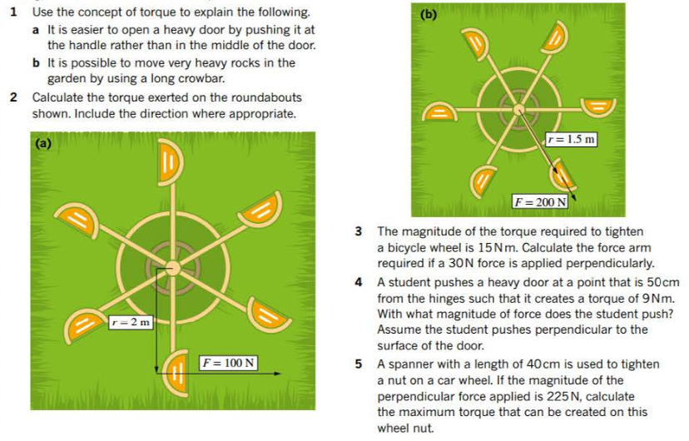

Torque
Additional Study

Slide 16
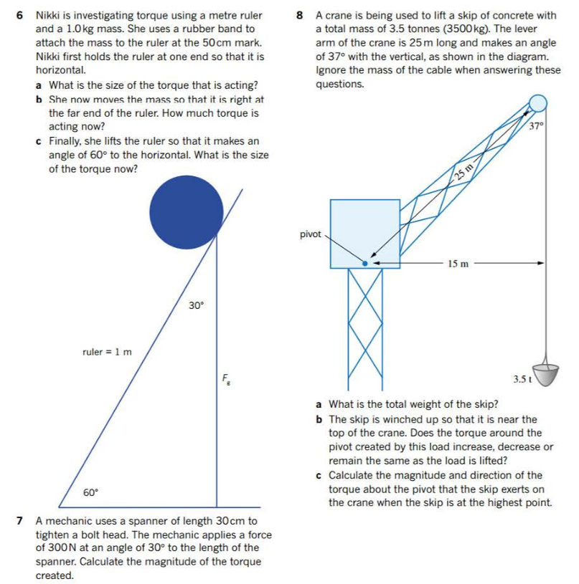
Torque
Additional Study

Slide 17
Centre of Mass and Stability
Success Criteria
I can define centre of mass and centre of gravity.
I can relate centre of mass to stability.

Slide 18
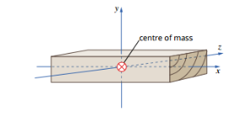
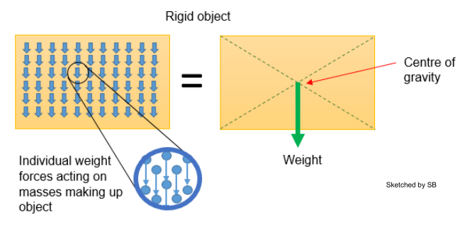

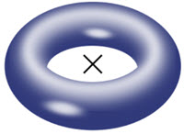
Centre of Mass
Content Development
The mass of an object can be considered to be ‘concentrated’ at a single point, called the centre of mass. For regular, uniform objects, where the mass is uniformly distributed, the centre of mass is usually the centre of the object. However, it doesn’t have to be. In fact, it doesn’t even have to be inside the object.

Slide 19
Centre of Mass
Content Development
The centre of gravity is the point where the weight of object is acting at. If the gravitational field is constant (all of Year 12 Physics), then the centre of gravity is the same as the centre of mass. You can use them interchangeably.
In exams, you will either be provided where the centre of mass of an object is or you can assume that it is in the centre of the object. Look for the keyword ‘uniform’. A uniform object has its mass equally distributed so its centre of mass will be in the middle.
A uniform metre ruler
W
W

Slide 20
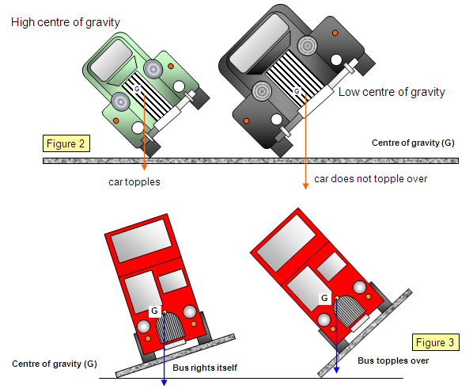
Stability
Content Development
Objects are stable (i.e., unlikely to tip) provided their centre of mass is over their base. If an object’s centre of mass extends past their base, the object will tip over.
This means that an object is more stable if it has:
  A lower centre of mass
  A wider base
These objects need to tip far more to become unstable.

Slide 21
Stability
Content Development
If an object’s centre of mass extends past their base, the object will tip over.
COM
COM
pivot
pivot
stable
unstable
torque due to gravity
pulls object back
torque due to gravity
pulls object down

Slide 22

Stability
You Do
You need to drive a bus on a road with a high angle slope. How can you reduce the risk of toppling? Explain your reasoning.

Slide 23
Stability
You Do
Compare the stability of the two shapes below. Both are the same mass and are uniform.

Slide 24
Centre of Mass and Stability
Success Criteria
I can define centre of mass and centre of gravity.
I can relate centre of mass to stability.

